Slide 1
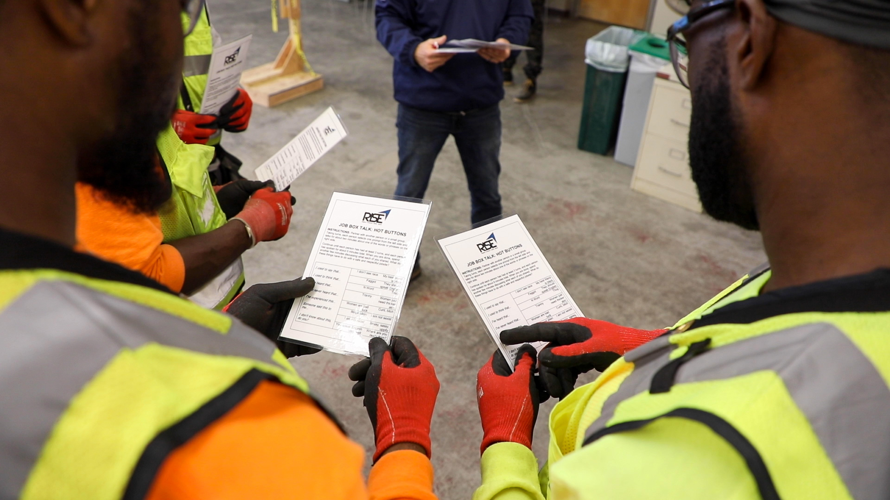
Ambassador Leadership
Understanding Influence

Slide 2
We work with employers to create work environments that meet the needs of a diverse workforce . Our program helps employers retain and develop skilled workers into the leaders of tomorrow.
We support the needs of workers at all phases of their development.
RISE UP was designed to meet the needs of the Trade Industry
The Ambassador program offers training in the skills needed to develop, advance and lead.
2
Notes:
How would you describe the culture of your workplace? What is the overall climate of your worksites? Have you taken the temperature of the workers on your sites? What is your view of the workers on your site?

Slide 3
Ambassador Leadership Preparation
Module 1: Culture and Influence
Culture
Social Norms
Culture Shifts
Module 2: Individual Influence
Personality and Communication
Preparing to Influence- Identifying My Style
Module 3: Tools of Influence
Bystander Intervention
Introduction to Conflict Resolution
3

Slide 4
Culture and Influence
Module One

Slide 5
Culture is …
The relationship formed by a group that shares, beliefs, values, and symbols.
Over time, the groups shared beliefs and values, are accepted and become social norms.
Social norms are the written and unwritten rules that guide behavior.
National
USA
Regional
West Coast
Gender
Male
Generation
Boomers
Social Class
Middle Class
Workplace
Blue Collar
RACE
Notes:
We live within many cultural systems that intersect with each other. Keep in mind, even though we live within these systems, we are not regarded in every system the same.

Slide 6
People Inform Culture Contains
Social Movements
Individual Persuasion
Anti-Litter/Recycling – Campaigns
Anti-Smoking Movement
Innovation and Technology
Automation
Computers
Internet
Our culture/environment each have by norms that guide behavior.
How others feel about our behavior influences attitude.
Individuals can influence norms.
Notes:
1980’s- Common for drivers to discard trash from car into the street.
1990’s- Smoking permitted in most public places.
Culture gradually shifts as it absorbs changes in society.

Slide 7
Pick a Norm… Any Norm
Workplace Norms | Social Etiquette Norms | Gender Specific
Notify supervisor when you are sick and unable to make it into work. | Do not talk with food in your mouth | Girls wear Pink Boys wear Blue
Be on time and follow the schedule you are given | Say hello when answering the phone and goodbye before you hang up | Men should be strong and not show emotion
Do not discuss your salary with co-workers | Do not pick your nose, belch or pass gas in public, if you must, say excuse me. | Women should be caring and nurturing
Can you think of a way technology has changed norms?
Describe a time when you were part of a group and believed one of its norms should change?
Can you think of a norm from your childhood that is no longer socially acceptable?
Can you think of a norm that could change because of COVID ?

Slide 8
Individual Influence
Module Two

Slide 9
Extraversion-Introversion
Our overall disposition/energy presents outward or inward.
Sensing- Intuition
How we receive and process information from the external world vs. our beliefs.
Thinking –Feeling
How we make decisions based on experience and logic vs. emotion
Judging-Perceiving
How we implement information based on a process or if we are inclined to improve and explore alternatives
Notes:
Have you ever met someone…

Slide 10
Conscientious
Organized
Prepared
Detail Oriented
Mindful
Agreeable
Kind
Affectionate
Cooperative
Empathetic
Extravert
Outgoing
Talkative
Social
Expressive
Open
Creative
Adventurous
Imaginative
Insightful
Personality Traits
Personality Types
Average
High Extrovert/Low Openness
Reserved
High Agreeable/ Low Openness
Role Model
High Extrovert/High Conscientious
Self- Centered
High Extrovert/ Low Conscientious

Slide 11
Communication Styles
PASSIVE
PASSIVE-AGGRESSIVE
These individuals are typically quiet, easy going, and avoid conflict.
They may not always express their feelings which can lead to miscommunication and built-up anger.
Passive communicators will engage if they are approached. Ask for feedback and encourage the sharing of ideas.
“It just doesn’t matter that much.”
These individuals are also typically quiet, manipulative, and are agreeable if they find it beneficial
They may not always express their true feelings or motives.
Behaviors: Frequent Sarcasm; words don’t match actions; facial expressions don’t match word.
“ Fine, whatever”.

Slide 12
Communication Styles
AGGRESIVE
ASSERTIVE
These individuals express their feelings by dominating, controlling, or intimidating
It is common for this type to issue demands without taking others into consideration.
They can also be considered leaders who command respect from those around them.
“Because I said so.”
These individuals are comfortable expressing their own needs, desires, and feelings, while also considering the needs of others.
It is common for this type to use “I” statements, taking ownership for their behavior without blaming others.
“We all have the right to express ourselves respectfully and honestly”.

Slide 13
Tools of Influence
Module Three

Slide 14
Bystander Effect
The bystander effect occurs when the presence of others discourages you from intervening in a situation. The more bystanders, the less likely any of them will provide assistance. People are more likely to intervene in a crisis when there are few or no other witnesses present.
WHY?
©2020
Notes:
The Bystander Effect is a term used to describe the tendency of individuals to feel less responsible to help or take action when they are in a group. There are many reasons why people choose not to get involved when they witness a threatening or uncomfortable situation, especially when there are others present. Some people just don’t want to get involved, or they look to others to step in, or they fear becoming a target themselves if they do or say something. In the workplace, being a passive onlooker to harassment and other abusive conduct can perpetuate a toxic work environment that can negatively affect many people beyond the direct targets.
When we intervene, we signal to the perpetrator that their behavior is unacceptable. If such messages are constantly reinforced on the work site, we can shift the boundaries of what is considered acceptable and problem behavior can be stopped.
Learning to recognize when someone is in danger and how you can intervene safely is an essential skill. Safely intervening could mean anything from a disapproving look, interrupting or distracting someone, not laughing at a sexist or a violent joke, or talking to a co-worker about their behavior in a non-confrontational way. It also means to ensure the care of the coworker who’s experienced problematic behavior. Other times, it means asking other co-workers, supervisors, or the public owner representatives for help.

Slide 15
What the bystander effect looks like
A little after 3 a.m. on March 13, 1964, Catherine “Kitty” Genovese parked her car and walked to her apartment in Queens, New York, after finishing her shift as a bar manager.
Serial killer Winston Moseley was out to victimize someone that night. Genovese became his target. When he followed her, she ran.
As Moseley reached her and began stabbing her with a hunting knife, Genovese screamed, “Oh, my God, he stabbed me! Help me! Help me!”
When lights in surrounding apartments flipped on and one man called out his window, the attacker ran and hid in the shadows. But no one came out to help. So Moseley returned and finished stabbing, then robbed and raped Genovese.
She continued to cry for help. The attack lasted about 30 minutes. As many as 38 people may have witnessed Genovese’s murder. Not one stepped outside to help her.
Notes:
The Bystander Effect is a term used to describe the tendency of individuals to feel less responsible to help or take action when they are in a group. There are many reasons why people choose not to get involved when they witness a threatening or uncomfortable situation, especially when there are others present. Some people just don’t want to get involved, or they look to others to step in, or they fear becoming a target themselves if they do or say something. In the workplace, being a passive onlooker to harassment and other abusive conduct can perpetuate a toxic work environment that can negatively affect many people beyond the direct targets.
When we intervene, we signal to the perpetrator that their behavior is unacceptable. If such messages are constantly reinforced on the work site, we can shift the boundaries of what is considered acceptable and problem behavior can be stopped.
Learning to recognize when someone is in danger and how you can intervene safely is an essential skill. Safely intervening could mean anything from a disapproving look, interrupting or distracting someone, not laughing at a sexist or a violent joke, or talking to a co-worker about their behavior in a non-confrontational way. It also means to ensure the care of the coworker who’s experienced problematic behavior. Other times, it means asking other co-workers, supervisors, or the public owner representatives for help.

Slide 16
Bystander Intervention
Identify
If something happens to you or someone else on the jobsite, don’t ignore it; bullying, hazing and harassment are not acceptable.
Address
There are many ways to intervene:
Direct – directly intervene
Distract: distract either party
Delegate: get help from others
Delay: check in later
Resolve
Work in partnership to make sure the issue is addressed and resolved. Retaliation against anyone making a report is prohibited.
Notes:
Has there ever been a time when you were either a victim or a witness of discrimination and you did/said nothing?
Why didn’t you intervene?
There are many reasons people don’t intervene. Maybe they thought they were the only one who felt that way or they didn’t want to go against the group. Maybe they felt they didn’t know what to do or were too shocked or angry to respond. And many times they just didn’t know what to do!
You know at some point you will see or hear something inappropriate or discriminatory. It is your responsibility to be prepared, know what you will say, and how you will handle it.
Sometimes it helps to identify the behavior. Point out their behavior to help them hear what they are really saying. “so what I hear you saying is no women should be allowing on the job site.”
Appeal to their principle by saying something like “I’ve always though you were fair minded. It shocks me to hear you say something so biased.”
Inform them the behavior will not be tolerated and follow through by taking action if the behavior continues.
Some other things you can do is make the person consider the victim’s perspective – imagine what they are thinking/feeling; imaging being in their situation; imagine if that was your daughter

Slide 17
Bystander Intervention - DIRECT
Direct Intervention
The bystander in this technique addresses the harasser or the victim in the moment.
Phrases to address:
“ We don’t do that kind of thing here”.
“ Stop! Why are you doing that?”.
“ Are you ok”? Do you need help?
“ Are you hearing what I am hearing? I can’t be the only one who thinks this in NOT ok.
Resolve
Be confident, assertive and remain calm when addressing the harasser. The goal is to stop the behavior not escalate it.
Notes:
Has there ever been a time when you were either a victim or a witness of discrimination and you did/said nothing?
Why didn’t you intervene?
There are many reasons people don’t intervene. Maybe they thought they were the only one who felt that way or they didn’t want to go against the group. Maybe they felt they didn’t know what to do or were too shocked or angry to respond. And many times they just didn’t know what to do!
You know at some point you will see or hear something inappropriate or discriminatory. It is your responsibility to be prepared, know what you will say, and how you will handle it.
Sometimes it helps to identify the behavior. Point out their behavior to help them hear what they are really saying. “so what I hear you saying is no women should be allowing on the job site.”
Appeal to their principle by saying something like “I’ve always though you were fair minded. It shocks me to hear you say something so biased.”
Inform them the behavior will not be tolerated and follow through by taking action if the behavior continues.
Some other things you can do is make the person consider the victim’s perspective – imagine what they are thinking/feeling; imaging being in their situation; imagine if that was your daughter

Slide 18
Bystander Intervention- DISTRACT
Indirect Intervention
Distraction can pause or stop the situation without confrontation.
Phrases and actions to address
Accidentally spilling or dropping something to draw attention.
Hey! It’s lunchtime, where are you going?
Creating a barrier in between the harasser and the victim.
Resolve
Once you have caused the distraction engagement.
Notes:
Has there ever been a time when you were either a victim or a witness of discrimination and you did/said nothing?
Why didn’t you intervene?
There are many reasons people don’t intervene. Maybe they thought they were the only one who felt that way or they didn’t want to go against the group. Maybe they felt they didn’t know what to do or were too shocked or angry to respond. And many times they just didn’t know what to do!
You know at some point you will see or hear something inappropriate or discriminatory. It is your responsibility to be prepared, know what you will say, and how you will handle it.
Sometimes it helps to identify the behavior. Point out their behavior to help them hear what they are really saying. “so what I hear you saying is no women should be allowing on the job site.”
Appeal to their principle by saying something like “I’ve always though you were fair minded. It shocks me to hear you say something so biased.”
Inform them the behavior will not be tolerated and follow through by taking action if the behavior continues.
Some other things you can do is make the person consider the victim’s perspective – imagine what they are thinking/feeling; imaging being in their situation; imagine if that was your daughter

Slide 19
Bystander Intervention- DELEGATE
Indirect Intervention
Bring a third party in to help can include going to an authority or signaling another bystander to call for help in the moment.
Phrases and actions to address
Enlist people in a position of authority.
Enlist another bystander:
Be specific by choosing the bystander you are enlisting.
“ Lady in the yellow jacket”, “Call for help”!
Resolve
Work in partnership to make sure the issue is addressed and resolved. Retaliation against anyone making a report is prohibited.
Notes:
Has there ever been a time when you were either a victim or a witness of discrimination and you did/said nothing?
Why didn’t you intervene?
There are many reasons people don’t intervene. Maybe they thought they were the only one who felt that way or they didn’t want to go against the group. Maybe they felt they didn’t know what to do or were too shocked or angry to respond. And many times they just didn’t know what to do!
You know at some point you will see or hear something inappropriate or discriminatory. It is your responsibility to be prepared, know what you will say, and how you will handle it.
Sometimes it helps to identify the behavior. Point out their behavior to help them hear what they are really saying. “so what I hear you saying is no women should be allowing on the job site.”
Appeal to their principle by saying something like “I’ve always though you were fair minded. It shocks me to hear you say something so biased.”
Inform them the behavior will not be tolerated and follow through by taking action if the behavior continues.
Some other things you can do is make the person consider the victim’s perspective – imagine what they are thinking/feeling; imaging being in their situation; imagine if that was your daughter

Slide 20
Bystander Intervention- DELAY
Indirect Intervention
Delay is an option if you can not intervene in the moment. Checking in with the person being harassed is an opportunity to support.
Phrases to address
“ Is everything ok”?
“ Is there anything I can do”?
“ Is there someone we can call”?
Resolve
Acknowledgement is important to people who are feeling isolated or bullied. Checking in could be a motivating factor for the person harassed to report it.
Notes:
Has there ever been a time when you were either a victim or a witness of discrimination and you did/said nothing?
Why didn’t you intervene?
There are many reasons people don’t intervene. Maybe they thought they were the only one who felt that way or they didn’t want to go against the group. Maybe they felt they didn’t know what to do or were too shocked or angry to respond. And many times they just didn’t know what to do!
You know at some point you will see or hear something inappropriate or discriminatory. It is your responsibility to be prepared, know what you will say, and how you will handle it.
Sometimes it helps to identify the behavior. Point out their behavior to help them hear what they are really saying. “so what I hear you saying is no women should be allowing on the job site.”
Appeal to their principle by saying something like “I’ve always though you were fair minded. It shocks me to hear you say something so biased.”
Inform them the behavior will not be tolerated and follow through by taking action if the behavior continues.
Some other things you can do is make the person consider the victim’s perspective – imagine what they are thinking/feeling; imaging being in their situation; imagine if that was your daughter

Slide 21
What would you do?
YESTERDAY
After clocking out from your shift, you see a woman you frequently cross paths with. You assume she works in your building but, do not personally know her.
As you both head to the parking lot, you notice there is a man standing next to her car. You are not close enough to hear their conversation, she didn’t seem scared, but she didn’t look pleased.
TODAY
You notice the same man. As the woman exits the building, she sees him, and freezes in place.
Notes:
Has there ever been a time when you were either a victim or a witness of discrimination and you did/said nothing?
Why didn’t you intervene?
There are many reasons people don’t intervene. Maybe they thought they were the only one who felt that way or they didn’t want to go against the group. Maybe they felt they didn’t know what to do or were too shocked or angry to respond. And many times they just didn’t know what to do!
You know at some point you will see or hear something inappropriate or discriminatory. It is your responsibility to be prepared, know what you will say, and how you will handle it.
Sometimes it helps to identify the behavior. Point out their behavior to help them hear what they are really saying. “so what I hear you saying is no women should be allowing on the job site.”
Appeal to their principle by saying something like “I’ve always though you were fair minded. It shocks me to hear you say something so biased.”
Inform them the behavior will not be tolerated and follow through by taking action if the behavior continues.
Some other things you can do is make the person consider the victim’s perspective – imagine what they are thinking/feeling; imaging being in their situation; imagine if that was your daughter

Slide 23
What would you do?
During the safety check meeting this morning everyone was notified that our new PPE had finally arrived and would be available for pick-up in the afternoon.
As instructed, you headed to the supply room. Only one person was ahead of you. You hear the person ahead of you inquire about a larger size, because what they received is too small.
You hear the supply tech say “ its not my fault, you’re too damn fat, MAKE IT WORK!
Notes:
Has there ever been a time when you were either a victim or a witness of discrimination and you did/said nothing?
Why didn’t you intervene?
There are many reasons people don’t intervene. Maybe they thought they were the only one who felt that way or they didn’t want to go against the group. Maybe they felt they didn’t know what to do or were too shocked or angry to respond. And many times they just didn’t know what to do!
You know at some point you will see or hear something inappropriate or discriminatory. It is your responsibility to be prepared, know what you will say, and how you will handle it.
Sometimes it helps to identify the behavior. Point out their behavior to help them hear what they are really saying. “so what I hear you saying is no women should be allowing on the job site.”
Appeal to their principle by saying something like “I’ve always though you were fair minded. It shocks me to hear you say something so biased.”
Inform them the behavior will not be tolerated and follow through by taking action if the behavior continues.
Some other things you can do is make the person consider the victim’s perspective – imagine what they are thinking/feeling; imaging being in their situation; imagine if that was your daughter

Slide 24
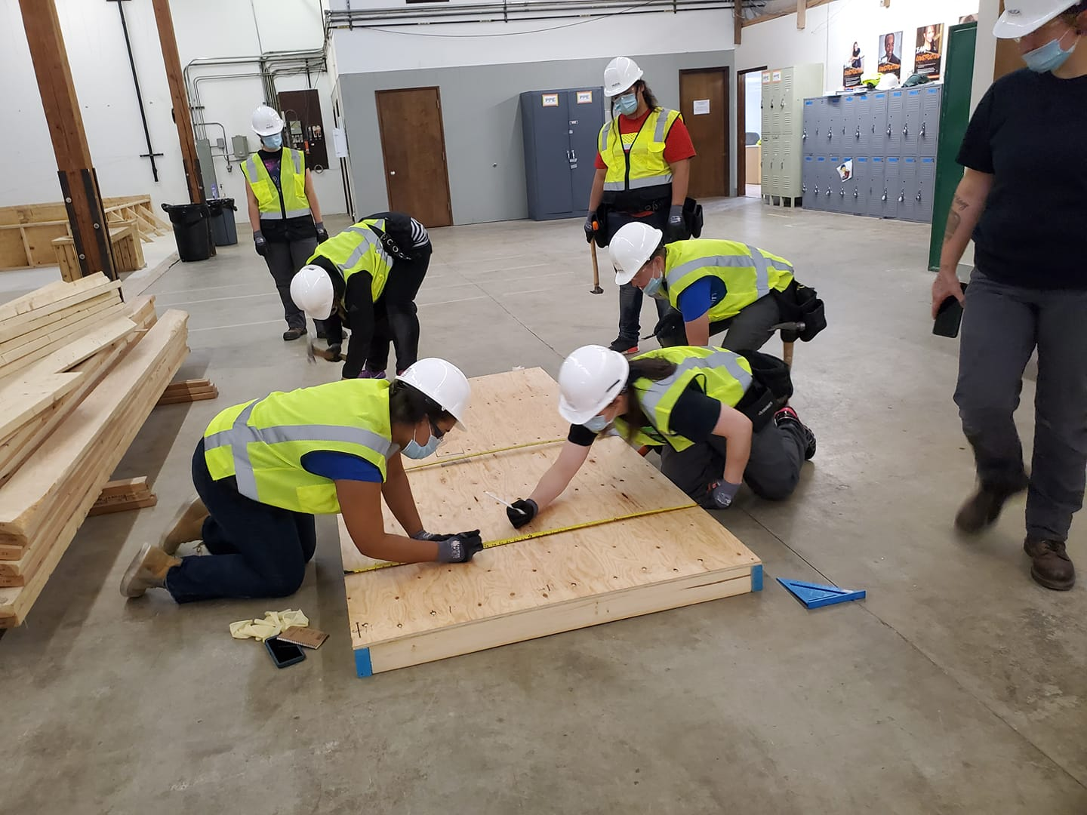
Bystander Awareness
You don’t have to do it alone, enlist the help of others.
Intervention is applied to behavior, not the person.
If you decide to intervene, use the style you are most comfortable with.
If you are uncertain, about the situation, check in with the person to see if they are ok.
Will your physical safety in danger, will your intervention escalate the situation.

Slide 25
Bystanders are the front line!
People inform what their culture contains.
Changing norms requires challenging behaviors.
Individuals will resist change, until the group requires it.
Changing a culture is a process not a project.
It takes people like you to change your environment for the better.
Notes:
People will resist change.

Slide 26
Conflict Resolution
1. Clarify the problem
2. Establish common goal
3. Discuss ways to meet goal
4. Determine barriers to goal
5. Agree on resolution
Notes:
Let’s face it, conflict happens all the time. It is a normal, inescapable part of life. It is also an opportunity to understand and appreciate opposing preferences and values.Situation: Person only good enough for the broom
It is important to address conflict in a direct, positive manner. The disagreement should be issue focused and not personal.
When approaching conflict with all parties in the conflict, you can utilize these steps.
Clarify what the disagreement is. Let both parties tell their side of the disagreement.
Establish a common goal for both parties.
Discuss ways to meet the goal.
Determine the barriers to meeting the common goal.
Agree on the best way to resolve the conflict. Make sure both parties agree to the solution and determine the responsibilities each party has in the resolution.

Slide 27
Conflict Resolution Applied
Choose a Scenario/Create a Response
Addressing a Lazy Co-worker
Supervisor/Colleague taking credit for your work
Approaching Supervisor for not providing appropriate PPE/Tools
Clarify the problem. What need isn’t being met?
Establish a common goal.
Discuss ways to meet the goal by listening and brainstorming together.
Determine barriers to the common goal by defining what can and cannot be changed.
Agree on the best way to resolve the conflict, by identifying the common ground and discuss how each party will maintain the solution.

Slide 28
Do’s and Don’ts of Resolving Conflict
Do’s and Don’ts of Resolving Conflict
DO
Acknowledge that conflict is going to happen – it is inevitable
Resolve conflicts quickly
Focus on the problem or behavior
Be open to solutions
Listen actively
DON’T
Focus on personality traits that can’t be changed
Interrupt
Disregard feelings
Avoid the conflict
Allow emotions to take over
Impose personal beliefs or values

